Slide 1



Justice Beyond the Cities: the State of Rural Public Defense in Texas
&
TIDC’s FY26-27 Legislative Appropriations Request
Webinar
January 8, 2024, 1pm

Slide 2
Roadmap
What TIDC Does
PPRI Rural Public Defense Needs Assessment
Addressing Major Issues Texas is Facing through TIDC’s LAR Exceptional Items
TIDC’s FY26-27 LAR Exceptional Items
Questions and Answers

Slide 3



What TIDC Does
FUNDING
OVERSIGHT
IMPROVEMENT

Slide 4
Rural Public Defense Needs Assessment

Slide 5


Justice Beyond the Cities: The State of Rural Public Defense in Texas
Needs Assessment of Public Defense in Rural Texas
Public Policy Research Institute

Slide 6
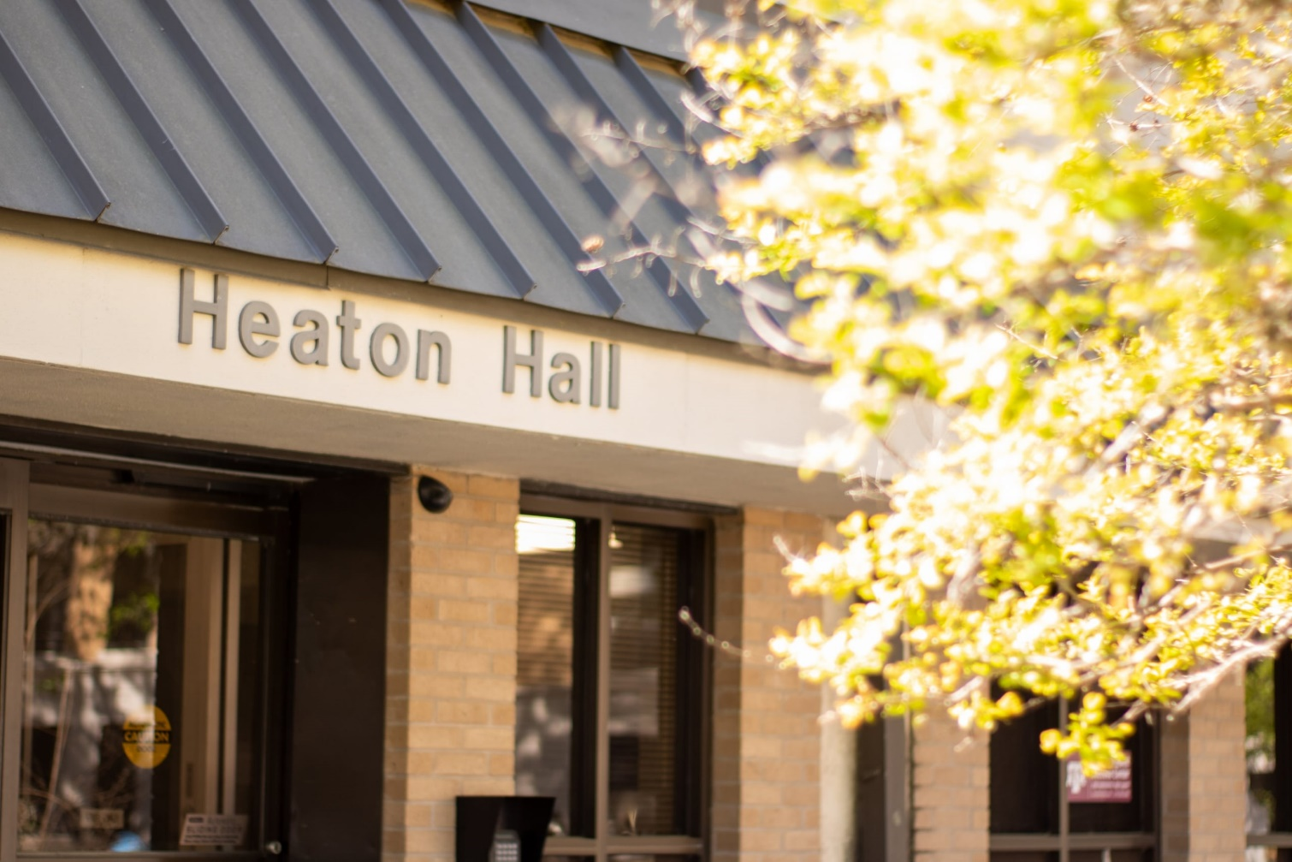
Intro
About PPRI
Agenda:
Biggest Issue for Indigent Defense in (Rural) Texas
Potential Solution?
Conclusions
A big thank you to the Texas Indigent Defense Commission for their support of the study.

Slide 7
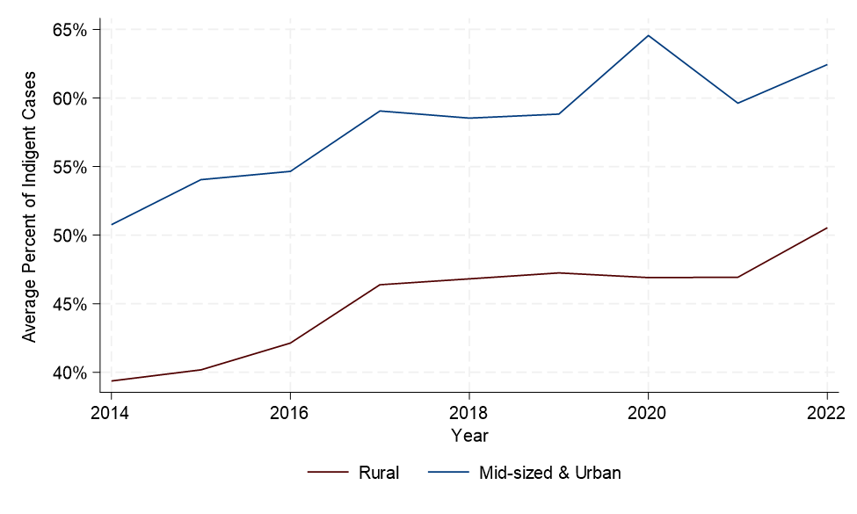
Indigent Defense in Texas
Over half of criminal defendants are deemed indigent
Counties determine how to provide counsel - PDO, MAC, contract counsel or private assigned counsel
Notes:
Public Defender Office (PDO), which employs full-time counsel and staff who serve indigent defendants of that county (or cluster of counties, called a Regional PDO) under the supervision of a Chief Public Defender;
Managed Assigned Counsel (MAC) Program, in which the judges designate a county department, nonprofit organization, or bar association, to appoint, pay, and monitor private counsel who represent indigent defendants;
Contract Counsel, through which the government contracts with a private attorney or law firm for a specified amount of money, time, and/or number of cases; and
Private Assigned Counsel, which involves the judicial assignment of a private attorney to represent an indigent defendant. The attorney is chosen from a pre-approved list via a system of rotation, often referred to as “the wheel.” This method of attorney assignment is the most prevalent around the state.

Slide 8
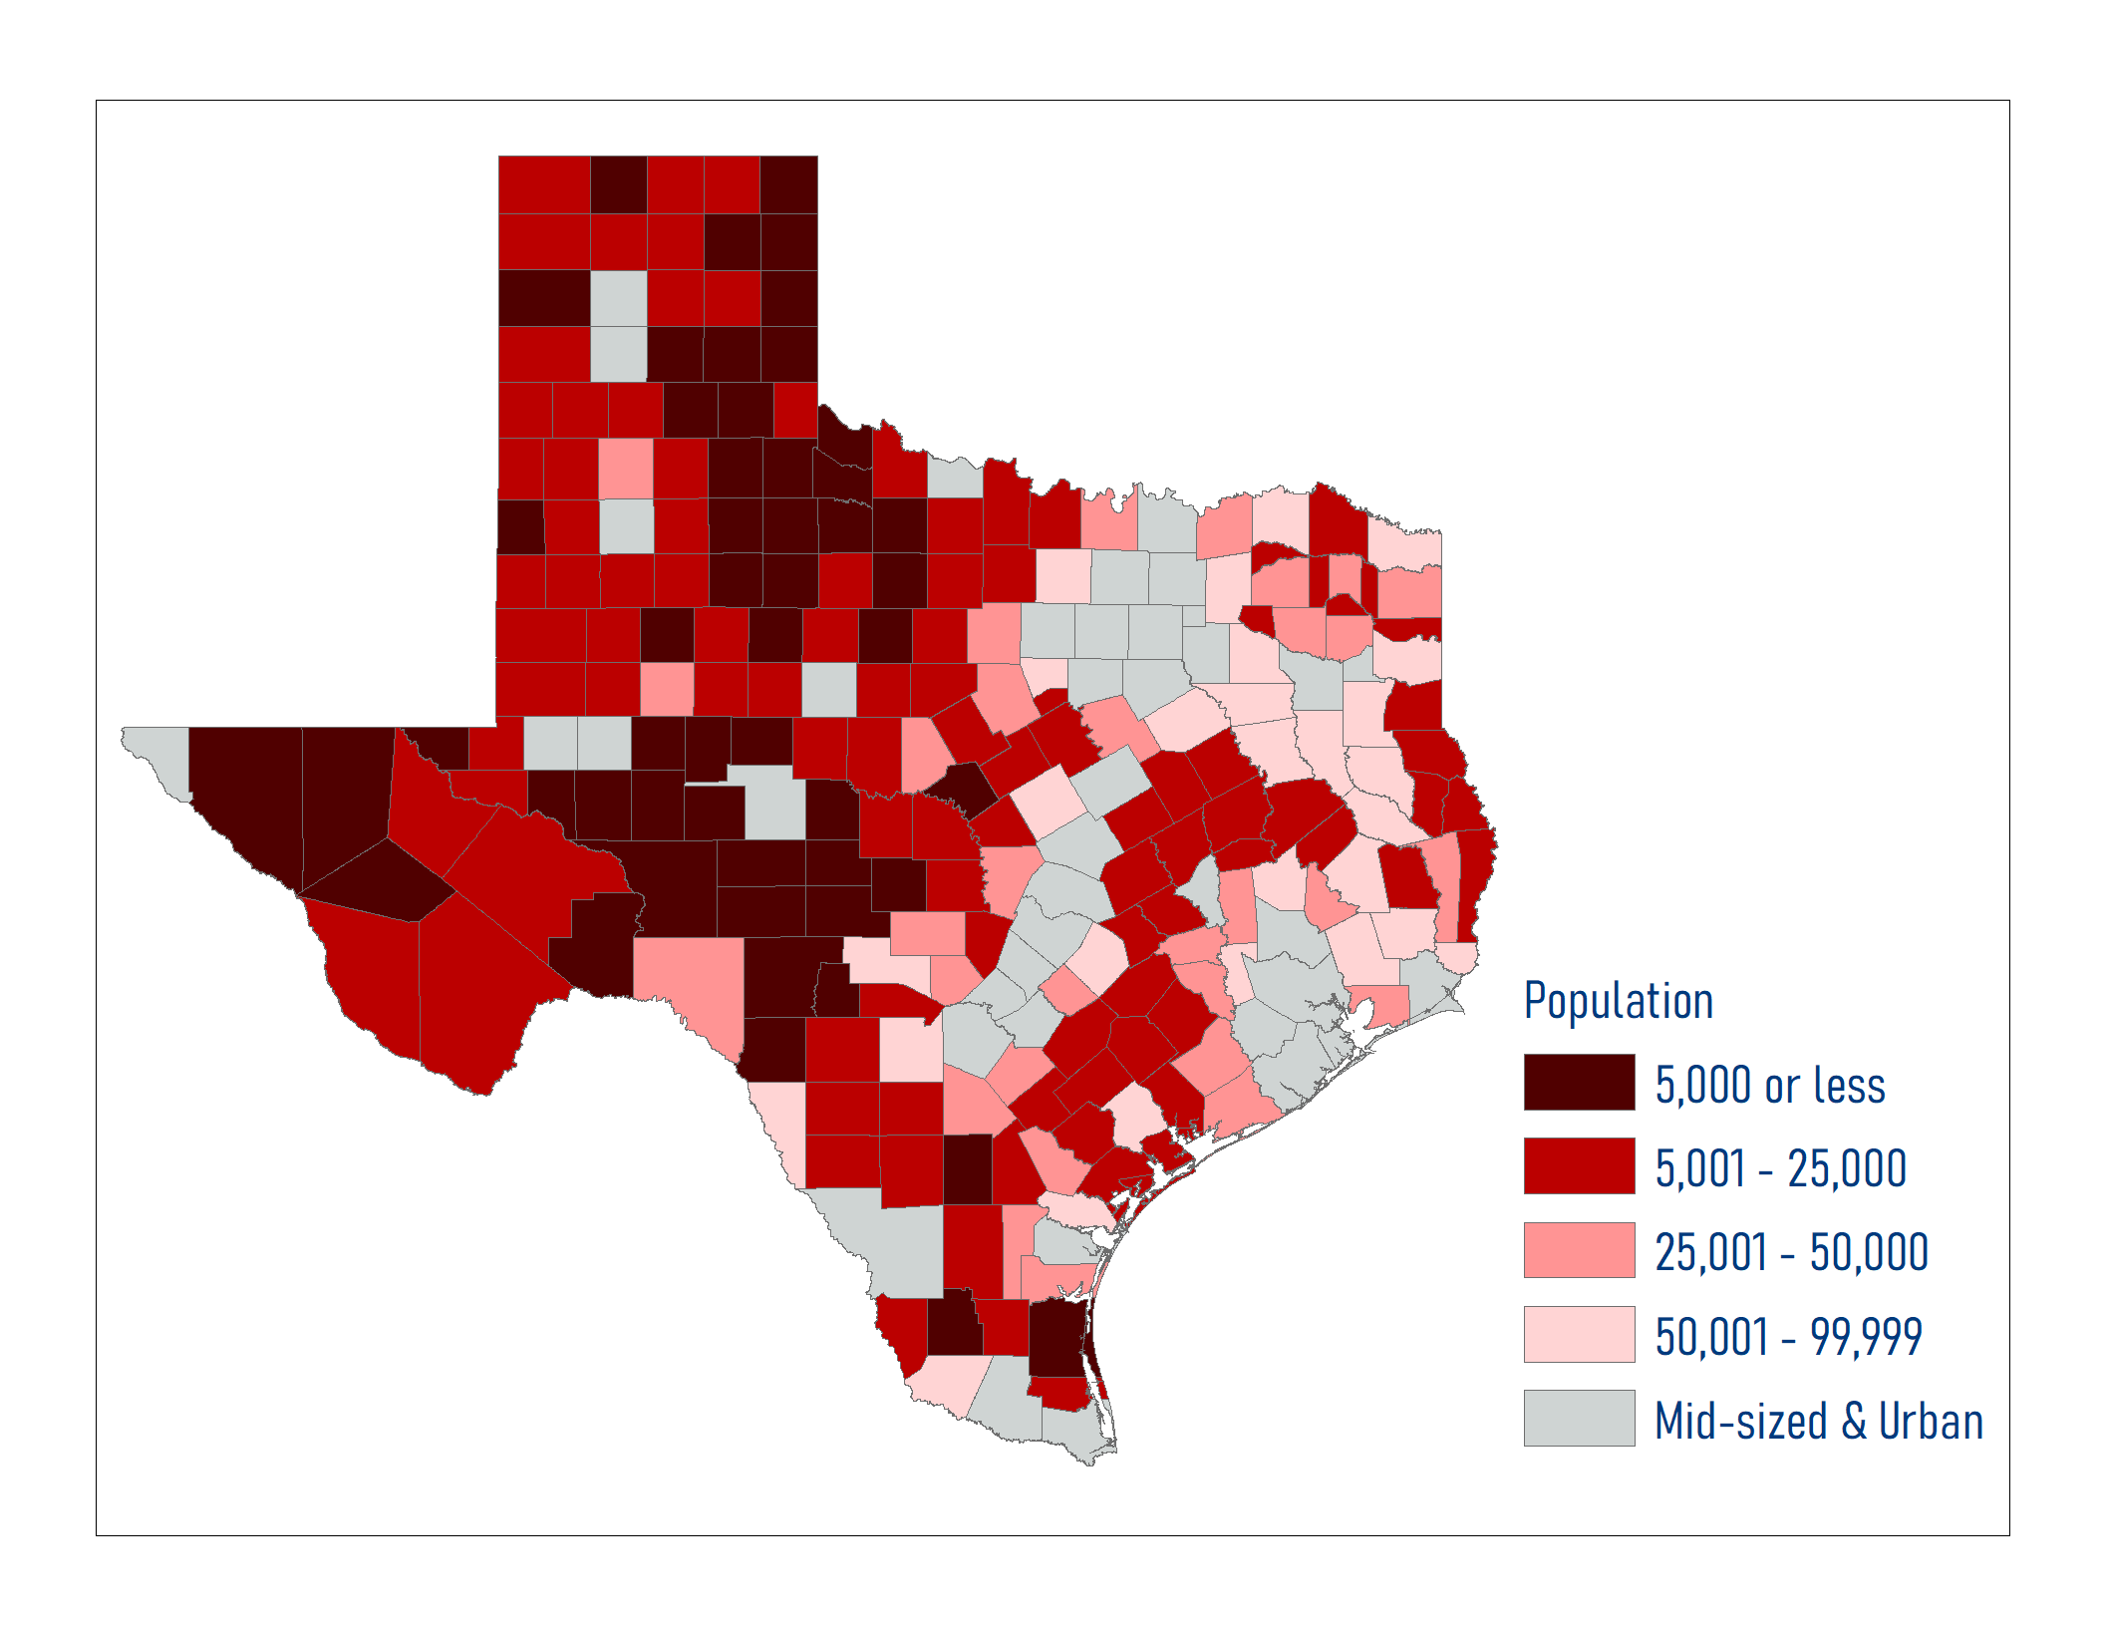
Study Background
Rural Counties in Texas
TIDC Budget Rider 19, p. IV-30
Review the needs of public defense across rural counties in Texas
Rural county defined with population <100K
Focus on non-capital criminal defense
Notes:
Counties are facing many challenges – lack of attorneys, lack of resources + there is quite a bit of variability in what we consider “rural” – county size, population and financial resources.
We were asked to study these concerns make recommendations on how to best address these
Request part of a budget rider in the General Appropriations Act for the 2024-2025 biennium
# of counties = 214 (Census 2020 Population) - 84% of counties
Non-capital criminal defense, not juvenile (unless noted); does not include family protection and child proections

Slide 9
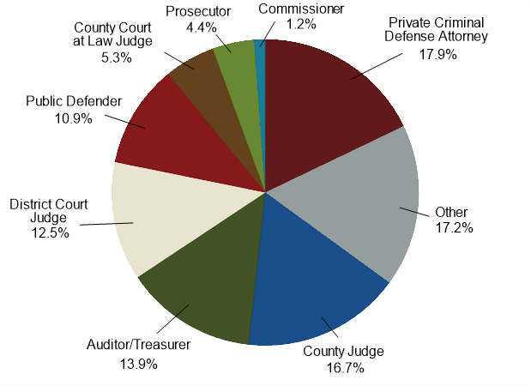
Methodology
Survey Response by Role
Mix-methods
  Online surveys
  Virtual interviews
  Macro-level data
Notes:
Online survey: October 24, 2023, to February 12, 2024
Over 700 responses - 431 responses from rural communities
Response from all but 3 counties: Brooks, Lamar, and Loving
Virtual interviews: November 2023, to February 2024
48
Judges, commissioners, private attorneys, public defenders, auditors, and county staff
Well represented responses across position and county; county officials had plenty of opportunities to participate

Slide 10
Biggest Issue Facing Indigent Defense in (Rural) Texas

Slide 11
We asked
Survey Respondents Perception of Issues related to Indigent Defense
Tell us about indigent defense in your area
Notes:
We asked what challenges are you facing in your area related to indigent defense

Slide 12
Main Takeaway: Attorney Availability Crisis
# of attorneys taking indigent cases
1926
1406
27% decline in number of rural attorneys taking at least one indigent defense case
Notes:
Attorney is the first and “only” thing people wanted to talk about; acute problem and needs urgent attention
Number of rural attorneys taking at least one indigent defense case is down 26.9% between 2014 and 2022: 1926 to 1406

Slide 13
Main Takeaway: Attorney Availability Crisis
Indigent case attorneys are older
“They're all just older attorneys...That's the issue...we've got some guys that are in their late 60s, some that are in their 50s, and you know one or two that might be in their 30s and 40s”
Notes:
Attorneys taking indigent defense cases are older, and most respondents argued that they barely know anyone in their 30s who is taking indigent defense cases
Average number of years since receiving law license is 21 years
Few new attorneys are entering public defense

Slide 14
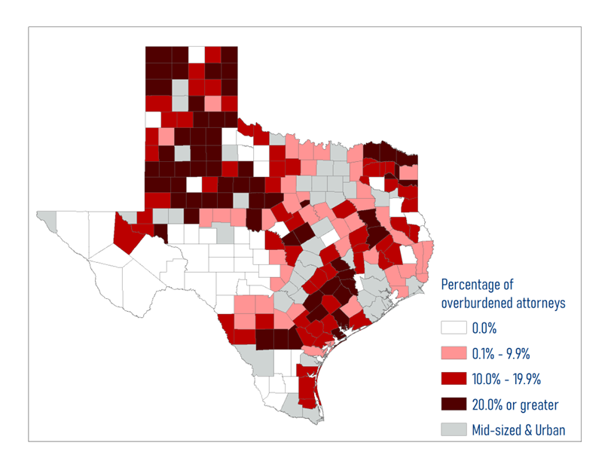
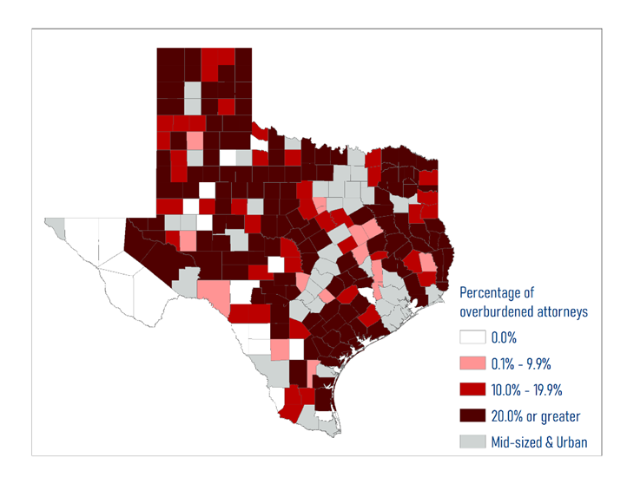
Main Takeaway: Attorney Availability Crisis
Overburdened: 1 out of every 4 attorneys
2014
2022
Notes:
Attorneys taking indigent defense cases are overburdened and this % has increased from about 15% to 27% and averages around 18% between 2014 and 2022

Slide 15
Attorney Motivation
Public Service
Joy of work
Low cost of living
Work-life balance
Closer to nature/lifestyle/family
“I wouldn’t move to the city right now because my commute is 5 minutes door to door. And you know, my house wouldn’t buy a shed in Dallas, but it is a pretty nice house. The cost of living makes it.”

Slide 16
Challenges for Rural Areas
Lack of legal specialization
Have to take indigent and private cases to make enough money
Relationships are key
Local ways of doing justice
Difficult to find resources/supports for clients
“So, if your practice is a pie and 25% of your practice is court appointments, you feel obliged to take [indigent cases] because the local judge or judges say, “hey, I need your help”, which is common. I am doing it for my community, I am doing it because the judge asked me to, and I get paid a little bit, so it balances out.”
” The biggest thing [judges] don’t want is someone that gets hired that’s not local, and they show up and they file every [expletive] piece of paper in every case, regardless. So that is not common sensical to many of them. It violates local custom, and it is a waste of resources.”

Slide 17
Are Public Defender’s Offices a Potential Solution?

Slide 18
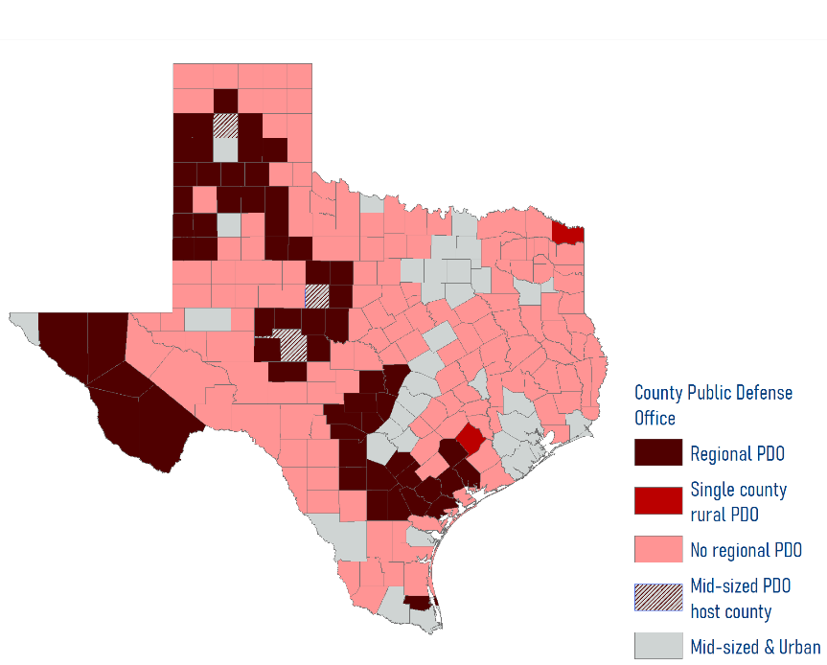
Expanding Public Defender Offices as a Solution
12 regional PDOs serving 57 rural counties and 3 mid-size counties
2 counties have own PDO
Notes:
Public defender offices provide jurisdictions with a centralized solution to representing indigent defendants. Counties may choose to establish an office which supports a single county or form a coalition with other counties to establish a regional PDO. These regional PDOs are often the best solution for rural counties as they can share the financial burden of supporting a PDO while reaping the benefits a PDO can offer their county. However, the current regional PDO model relies heavily on the counties to come together to form an agreement of where the regional PDO will be located and how the resources will be shared. This can lead to some counties being surrounded by counties served by regional PDO offices with no way to enter into an agreement to participate.

Slide 19
Have a PDO
Overall, How Satisfied are You With Your Public Defender’s Office?
How well does your PD office address these issues?
With respect to caseload, our survey revealed, 27.6% of respondents in counties with a PDO feel their PDO has an excessive caseload while 37.4% do not (with 35.0% expressing uncertainty).
Notes:
Just over a third of rural survey respondents have a PDO for non-capital cases in their county (Figure 20). Among these, 8.9% have a single county office, while 29.7% are served by offices covering multiple counties or regions. Conversely, slightly more than half of respondents (53.4%) lack a PDO in their county, while the remaining 8.1% are uncertain about the presence of a PDO.

Slide 20
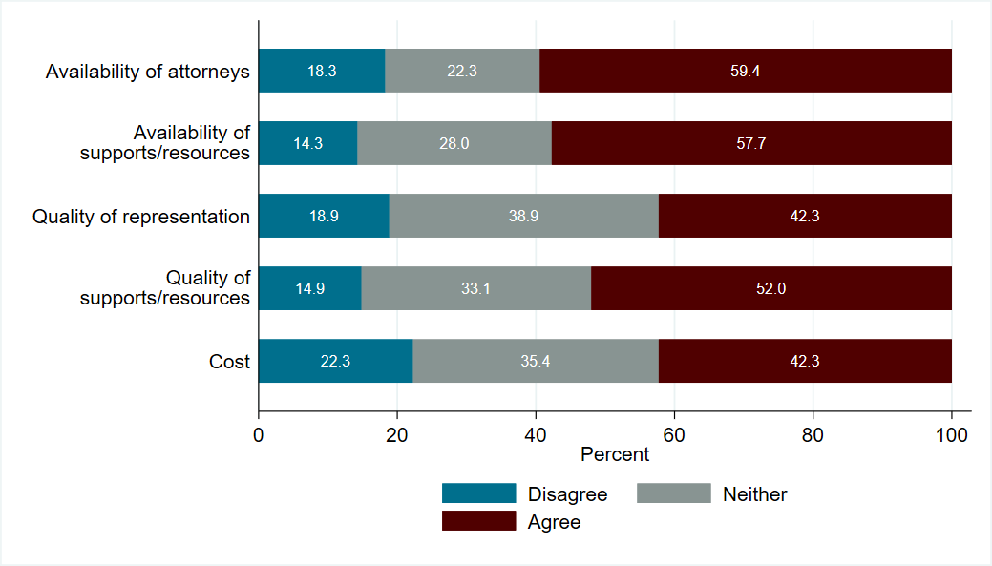
Do not have a PDO
Our County Would Benefit From Having a Public Defender’s Office
How well would a PD office improve these issues?
Notes:
Additionally, interview participants in an area without a PDO share their perceived benefits to establishing a PDO. Benefits to the county include:
Sharing resources with other participating counties;
Solving attorney availability issues;
Improving the quality of attorneys in the area;
Saving the county money;
Providing defendants with representation; and
Improve court efficiency.

Slide 21
Do not have a PDO
It should be emphasized that many judges in rural areas were interested in a PDO because they felt that was the only possible solution to increasing the number of attorneys available in their county, while also having the benefit of taking the burden of assigning the attorney from the judge.
“I would love to have a public defender’s office to come over here where I can assign somebody and I make sure it makes my court run faster, smoother, and there’s less waste. And it’s not going to solve everything, but it would make things a lot easier.”
Notes:
Additionally, interview participants in an area without a PDO share their perceived benefits to establishing a PDO. Benefits to the county include:
Sharing resources with other participating counties;
Solving attorney availability issues;
Improving the quality of attorneys in the area;
Saving the county money;
Providing defendants with representation; and
Improve court efficiency.

Slide 22
Establishing a PDO
Under What Circumstances Would You be Willing to Establish a Public Defender’s Office?
Financial consideration is the main obstacle to establishing a PDO

Slide 23
Attorney Benefits to Join a PDO
Job security
Work with others including legal support
Mentorship and training opportunities
Student loan repayment
Notes:
Note that there is still a need for non-PDO attorneys for cases with different level of conflict.

Slide 24
Conclusions
Attorney availability is biggest concern followed by monetary costs
Attorney motivation to take cases is often intangible
There is support to establish PDOs as a viable solution

Slide 25
Recommendations related to TIDC’s LAR
01
Develop a comprehensive program to increase the number of attorneys
02
At a minimum TIDC needs $23.5 million per year to establish and operate new regional PD offices covering one third of rural counties without a PD office today
03
TIDC should embark on an outreach campaign to rural communities
04
As much as possible, ensure that all current PD offices have sustainable funding
Notes:
The program should be the outcome of collaboration between counties, TIDC, PDOs, and law schools across the state. The program could include but is not limited to loan repayment, internship and fellowship opportunities for law school students, webinars, and resource sharing. The program should also create a recruitment campaign at both Texas and non-Texas law schools as well as a recruitment campaign for experienced attorneys to join public defense. As a part of the program development, an evaluation component should be employed to determine which components most strongly influence attorneys to join public defense, and specifically rural defense.
Counties’ first response to attorney shortage is to increase court appointment fees resulting in varying degrees of success. TIDC should evaluate the data provided by counties in their Indigent Defense Expenditure Reports to determine the current appointment fees. The analysis should consider factors like a county's capacity to boost its tax revenue and should also identify how historical successes in raising appointment fees have helped alleviate attorney shortages. Key stakeholder interviews with county officials and local attorneys can validate the Indigent Defense Expenditure Reporting (IDER) findings.
TIDC needs to engage more purposely with rural counties to develop a working relationship. This relationship will allow cooperation and trust in addressing the needs of indigent defense. To do this, we propose TIDC expand its current outreach efforts with the help of new staff. TIDC should increase its visits to counties interested in establishing a rural regional PDO. These expanded visits, which are not associated with any punitive action, should be focused on relationship building, which is key to establishing buy-in from rural communities.
While TIDC currently provides two-thirds sustainability funding for rural regional public defender offices, some counties struggle to afford the cost of the office even at this level of support. Other counties cannot afford to join, even with two-thirds sustainability funding, because of their limited tax base. PDOs are established in rural areas to add attorney capacity. If funding constraints force a PDO to close, legal representation capacity is lost and will be difficult to build back up with private assigned counsel alone. TIDC should examine how it can increase its sustainability funding support for counties who cannot afford a regional PDO under its current two-thirds funding model.
A more consistent presence of TIDC across the state allows the agency to be on top of the current challenges, build and maintain strong relationships with stakeholders, and allows counties to engage with the state agency. Creating regional TIDC offices can achieve these goals while still maintaining a local identity. Other agencies in Texas have regional offices that are either extensions of said agency or support a state agency mission. Examples include Texas Department of State Health Services, Texas Education Agency, and Texas Workforce Commission. In each of these regional models, local practitioners most commonly interact with and develop a relationship with their regional office contacts (as opposed to the head state agency). TIDC would have to find a regional model that befits their structure and purposes specifically, but regional offices would likely generate better connections between counties and TIDC, especially in rural areas, where relationships are vital to the criminal justice system. To implement regional offices, additional staff would need to be hired. These staff can be tasked with visiting local counties (for compliance, grant monitoring, etc.), providing technical assistance and support, organizing outreach between counties and local bar and TIDC, ensuring TIDC information is reaching the right parties, among other duties.

Slide 26


Copy of Report->
Thank you!
gnaufal@tamu.edu
enaiser@tamu.edu
ppri.tamu.edu
Notes:
Search for “tamu ppri” on each of the listed social media, and our profile will appear.

Slide 27

Major Issues Facing
Texas and TIDC
&
TIDC’s LAR Exceptional Items
Read TIDC’s Legislative Appropriation Request here:

Slide 28
Major Issues Facing TIDC & Texas
Legislature authorized TIDC to work on family protection representation – but no funds appropriated
Major shortages of indigent defense attorneys – criminal, juvenile, and family protection representation – in rural Texas (and non-rural)
TIDC staffing needs: family protection representation, recruiting efforts
Operation Lone Star
Significant shortfalls in the Fair Defense Account, need more reliable source(s) of revenue

Slide 29
Exceptional Item #1:
Appropriate $12 Million in General Revenue to Address Funding Shortfall in the
Fair Defense Account

Slide 30
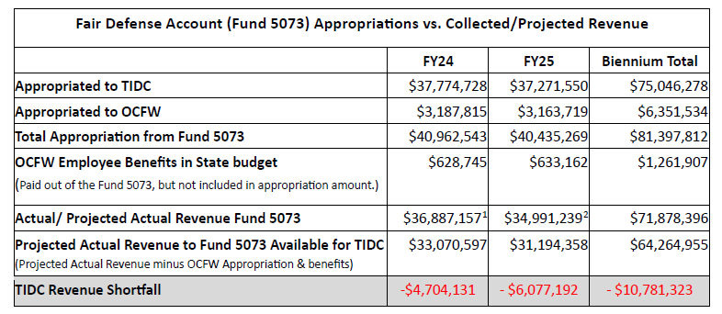
FY24/25
Fair Defense Account Revenue Shortfall
TIDC has historically received approx. $6 million a year from the Juror Pay fund. Requesting $12 million would make up for that shortfall. However, compared to FY18, revenue is down approx. $10m per year.

Slide 31
Fair Defense Account Revenue Shortfalls
Fair Defense Account (Fund 5073) Revenue
In FY2018, the Fair Defense Account (FDA) collected $45.8 million
For FY2024, the FDA collected about $36.3 million – about $9.5 million less than FY18
Compared to FY18 revenue levels, the FDA is down $54.7 million cumulatively from FY19-24
Funding from Juror Pay used to be ~$6 million per year; future expected to be $0
Court cost collections are ~$4 million less per year than historic levels
Received

Slide 32

Potential Funding Source for Revenue Shortfall
Allocate 1% of Mixed Beverage Taxes to the TIDC’s GR-D Account 5073 (Fair Defense Account).
  Raises approx. $15 million per year.
Approx. $30 million per year in indigent defense costs due to DWI cases.

Slide 33
Exceptional Item #2:
Reduce Attorney Shortages through Internships, Fellowships, and Student Loan Repayment

Slide 34



Reduce Attorney Shortages through Internships, Fellowships, and Student Loan Repayment
Exceptional 4a
Exceptional 4b
Exceptional 4c
Rural Recruitment
Grants to Institutions Funding Internships
$480,000 per year supports
Up to 96 law student interns
(approx. 2 interns in each of 30 offices/per year)
$960,000 biennium
Rural Recruitment
Grants to Institutions Funding Fellowships
$90,000 per participant
$1.35 million per year supports 15 one-year fellowships
$2.7 million biennium
Rural Recruitment
Student Loan Repayment or Scholarship Program
Incentivizes 4-year attorney commitments
$5 million biennium
Implemented by Texas Higher Education Coordinating Board

Slide 35
Exceptional Item #3:
Provide Funding to Implement the Family Protection Representation Program

Slide 36
History of Reported County
FPR Spending
FY21: $66,238,774
FY22: $61,573,531
FY23: $62,780,536
22-23 Biennium: $124,354,067
3-Year Annual Average:
$63,530,947

Slide 37
LAR Exceptional Item #3 Ask
Match % for Texas CASA state funding (37%)
$23.23 million per year, Biennium: $46,457,596
5 FTEs
  1 Title IV-E staffer to increase federal reimbursement
  1 grant specialist
  1 fiscal analyst
  2 policy analysts

Slide 38

Where Will the Money Go?
Formula Grants
Improvement Grants including component for pre-petition legal representation
5 additional TIDC staff

Slide 39
Exceptional Item #4:
$35 million to Increase Public Defense Capacity through New and Expanded Public Defender Offices

Slide 40
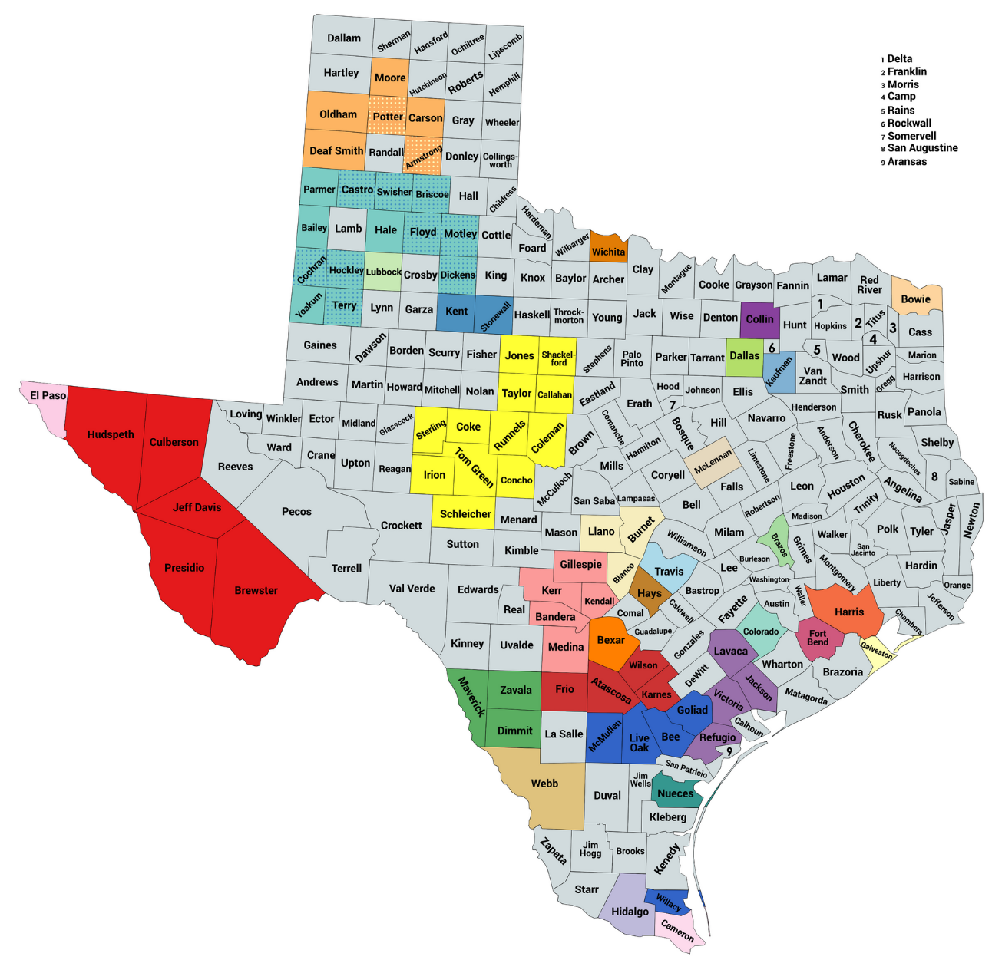
Public Defense Offices
Serve over 80 counties across the state
Incl. rural regional public defender offices, single-county public defender offices, and managed assigned counsel programs
3 statewide offices
  RPDO-Capital Cases
  Office of Capital & Forensic Writs
  State Counsel for Offenders

Slide 41
Funds Needed to Build Capacity
~ $23.5m/year to establish, operate rural regional PDOs covering 1/3 of counties w/o office
2 years to set up this number of offices
Does not include funds for mid-sized or urban counties
Does not include funds to help more needy counties who can’t afford to pay 1/3 of cost of office
Ask: $35 million to cover new rural regionals; mid-sized and urban county needs; and needy counties who can’t afford 1/3 cost of office

Slide 42
TIDC’s FY 26-27 LAR Exceptional Items
  Appropriate $12 Million in General Revenue (GR) to address funding shortfall in the Fair Defense Account.
  Appropriate $8,941,793 in GR to reduce attorney shortages through a “pipeline program” consisting of internships, fellowships and loan repayment or scholarships for attorneys working in high need areas, which includes 1 FTE to implement and operate the program. Reduce Attorney Shortages through Internships, Fellowships, and Student Loan Repayment:
  Appropriate $47,548,803 in GR to operate TIDC’s Family Protection Representation program, which includes funds for grants to counties and 5 FTEs to implement and operate the program.
  Appropriate $35 million in GR to increase TIDC’s capacity to fund new and expanded public defense offices.
Notes:
Appropriate $8,941,793 in GR to reduce attorney shortages through a “pipeline program” consisting of internships, fellowships and loan repayment or scholarships for attorneys working in high need areas, which includes 1 FTE to implement and operate the program. Reduce Attorney Shortages through Internships, Fellowships, and Student Loan Repayment:
A: Internships: $960,000
B: Fellowships: $2.7 million
C: Student Loan Repayment/Scholarship: $5 million (THECB)

Slide 43

Questions?
Read TIDC’s Legislative Appropriation Request here:
Read TIDC’s Board-Approved Legislative Proposals here:

Slide 44
Contact:
Scott Ehlers
Executive Director
sehlers@tidc.texas.gov
512-936-7551
Wesley Shackelford
Deputy Director
wshackelford@tidc.texas.gov
737-279-9208
Crystal Leff-Piñon
Director of Family Protection Representation
cleff-pinon@tidc.texas.gov
737-279-9461

